Slide 1

Mr.Sower Engineering Exploration Course Project
Pranav S Bhat | 01FE21BCS230
Ankith Chavan | 01FE21BCS243
Faheem Dehalvi | 01FE21BEE083
Mahendraraddi Iraddi | 01FE21BEC220
Under the guidance of
Mrs. Madhu Asundi
2021-2022, Even Semester
CEER, KLE Technological University, Hubballi

Slide 2
Problem Definition
Design a semi-automatic seed sowing machine which sows seeds in pots. The machine should be portable and user friendly. The machine's dimensions should be within 2x2 feet, should plant at least 2-3 pots in a row. The pot size should be 7-9 cm in diameter. It should dispense 3-5 seeds in one pot by an appropriately sized hole. The project should be delivered within 3 months. It should first dispense soil, sow some seeds and the cover the seeds with a little amount of soil. The machine should sense for the availability of pots and should stop when pots finish. The machine should also indicate when the sowing process has been completed

Slide 3
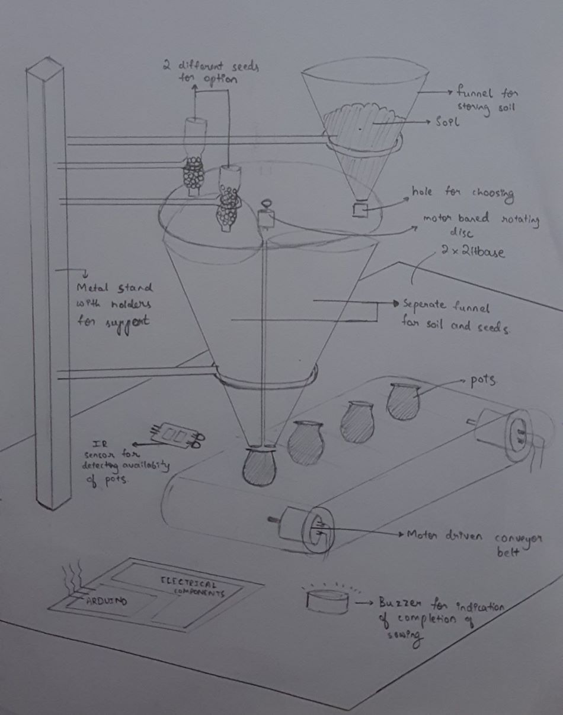
Generated Concepts
DESIGN 1

Slide 4
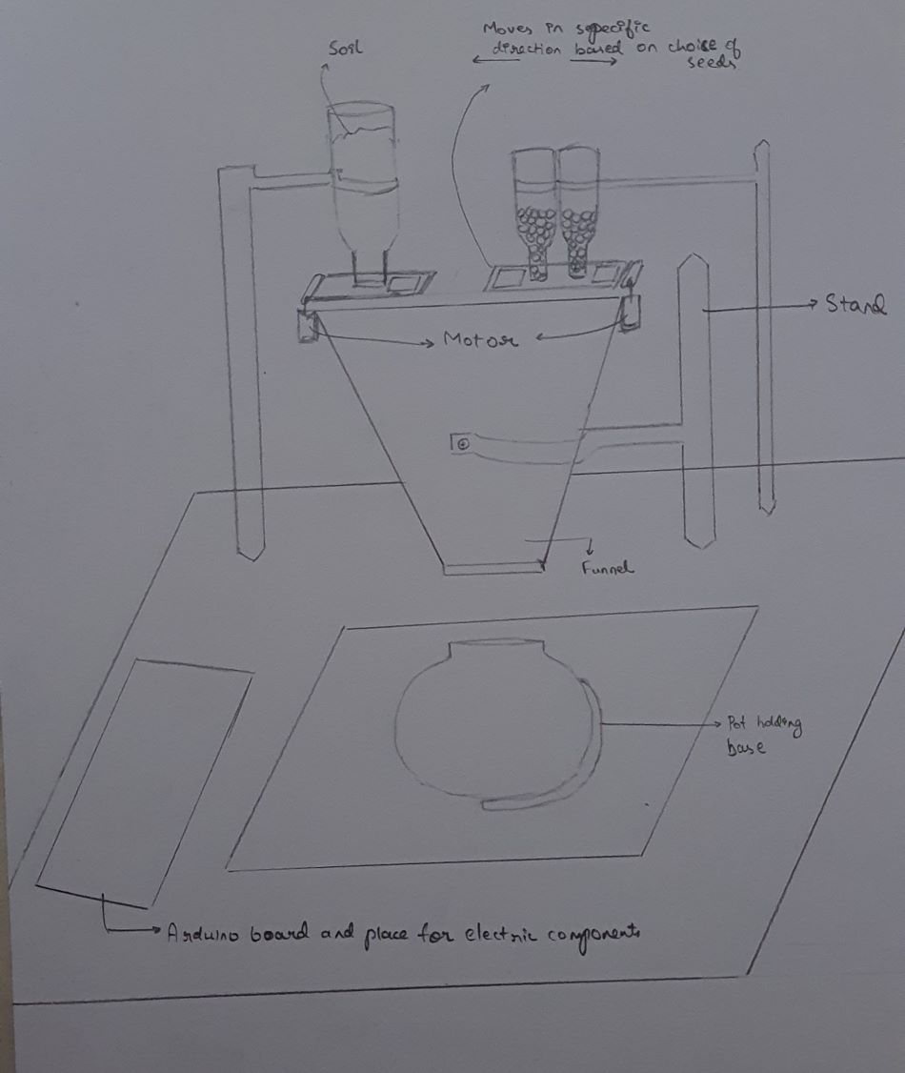
Generated Concepts
DESIGN 2

Slide 5
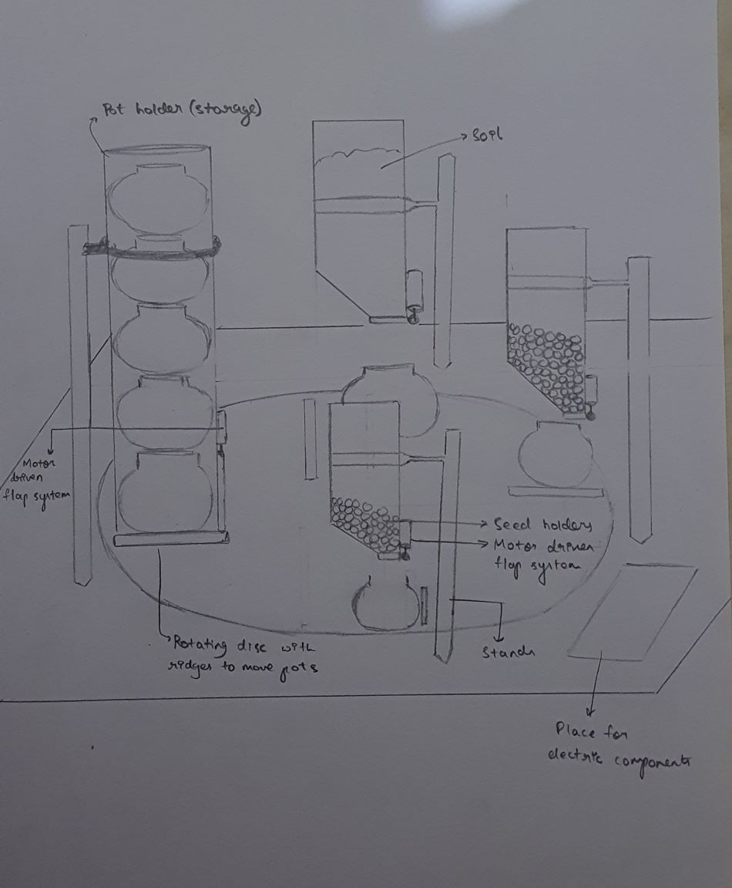
Generated Concepts
DESIGN 3

Slide 6
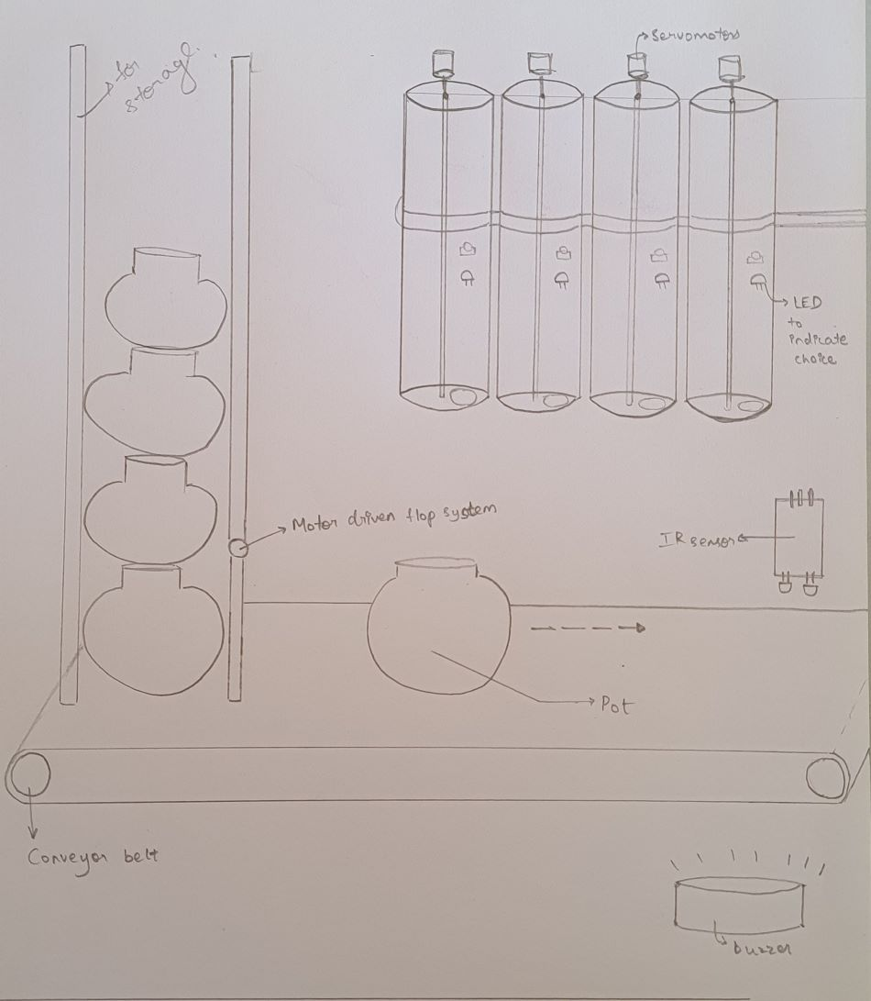
Generated Concepts
DESIGN 4

Slide 7
Selected Concept

Slide 8
Virtual Implementation

Slide 9
3D model of the entire system

Slide 10
Circuit diagram of the entire system

Slide 11
Physical Implementation

Slide 12
SPRINT 1

Slide 13
SPRINT 2

Slide 14
SPRINT 3

Slide 15
Learning from course project/exploration course
How to carry out the process of brainstorming for a particular idea.
How to systematically and efficiently carry out the different parts of a design
How to work in a team and respect each other ideas
How to build and develop a virtual or theoretical idea into a physical model
How to work with different components and tools which are important in the journey as an engineer
The importance of proper planning and time management
Importance of life skills such as patience, hard work, prioritization and so on.

Slide 16
Thank You

